Slide 1
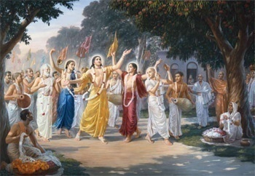
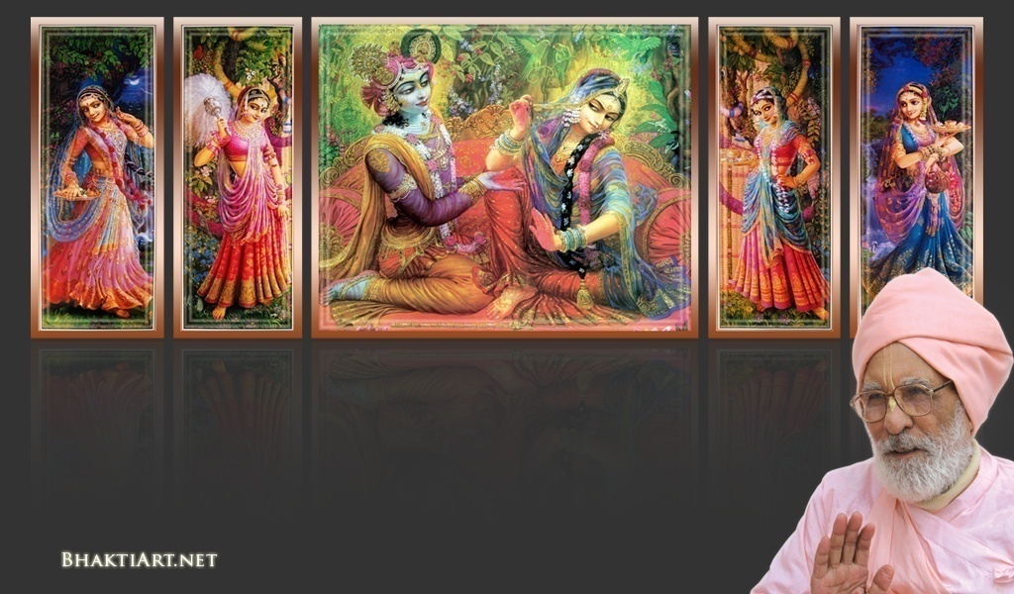
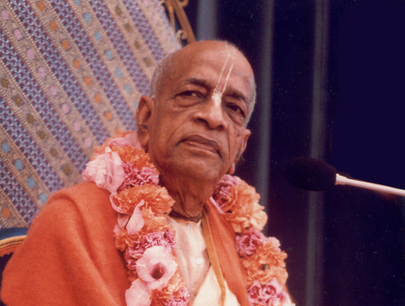
Sri Krsna Caitanya Prabhu Nityananda
Sri Advaita Gadadara Srivasadi
Gaura Bhakta Vrinda
Week 342
May 08 2015
Hare Krsna Hare Krsna
Krsna Krsna Hare Hare
Hare Rama Hare Rama
Rama Rama Hare Hare
Gokul Bhajan & Vedic Studies
North Carolina, USA
Notes:
Om Ajnana timirandhasya, jnananjana salakaya
Caksur unmimiltam yena, tasmai sri gurave namah
Namah om vishnu padaya, radhikayah priyatmane
Sri-srimad bhaktivedanta, narayana iti namine
Sri krishna lila kathane sudaksham
Audarya-madhurya gunais ca yuktam
Varam varenyam purusham mahantam
Narayanam tvam sirasa namami
He krishna karuna sindho, dina bandho jagat pate
Gopesha gopika kanta, radha kanta namo ‘stu te
tapta kancana gaurangi, radhe vrindavaneshvari
vrsabhanu sute devi, pranamami hari priye
bhajami radham aravinda netram
smarami radham madhurasmi-tasyam
vadami radham karuna bharardram
tato mam anyasti gatir na kapi
bhaktya vihina aparadha lakshai
ksiptas ca kamadi taranga madhye
krpamayi tvam saranam prapanna
vrinde numas te caranara vindam
--------------------------
First of all, I pay my koti dandavat pranams to my diksha guru Om vishnupada rupanuga acharya Sri Sri Bhakti Vedanta Narayana Goswami maharaja. My koti dandavat pranams to Sri Sri Bhakti Vedanta Swami Prabhupada, and guru varga.
My humble pranams at the lotus feet of all assembled devotees, vaishnavas and vaishnavis..

Slide 2
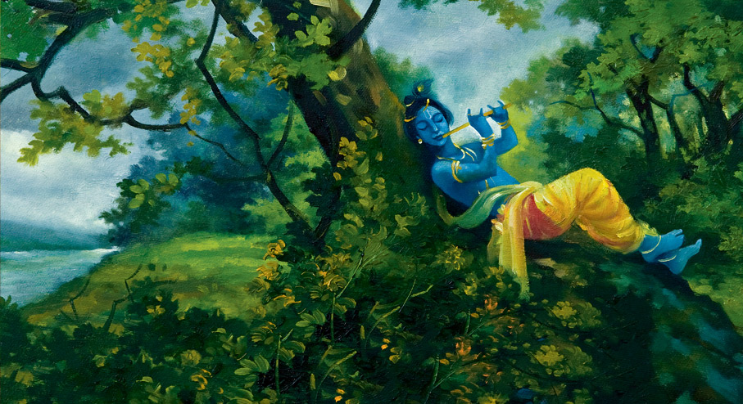
Pilgrimage Memories -5 Vrindavan!

Slide 3
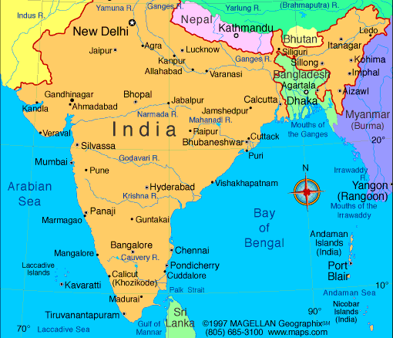
4 Weeks from Feb 23..
Chennai -> Kurdha Rd
Kurdha Rd to Puri
Puri to Calcutta
Calcutta to Nawadwip
Nawadwip to Calcutta
Calcutta to Delhi
Delhi > Aniruddh Prabhu
Aniruddh home to Jaipur
Jaipur to Mathura Vrindavan
Mathura to Pune, Kurdvadi
Kurdvadi to Pandarpur
Pandarpur to Kurdvadi
Kurdvadi to Manthralaya
Manthralaya to Sindhanur
Sindhanur to Kishkintha
Kishkintha to Sindhanur
Sindhanur to Bangalore
Bangalore to Chennai
Chennai to Kanyakumari
Notes:
....
Coromandal express.. Reservation was pending for months..
But on that day it got confirmed..
Muslims in the train at midnight..

Slide 4
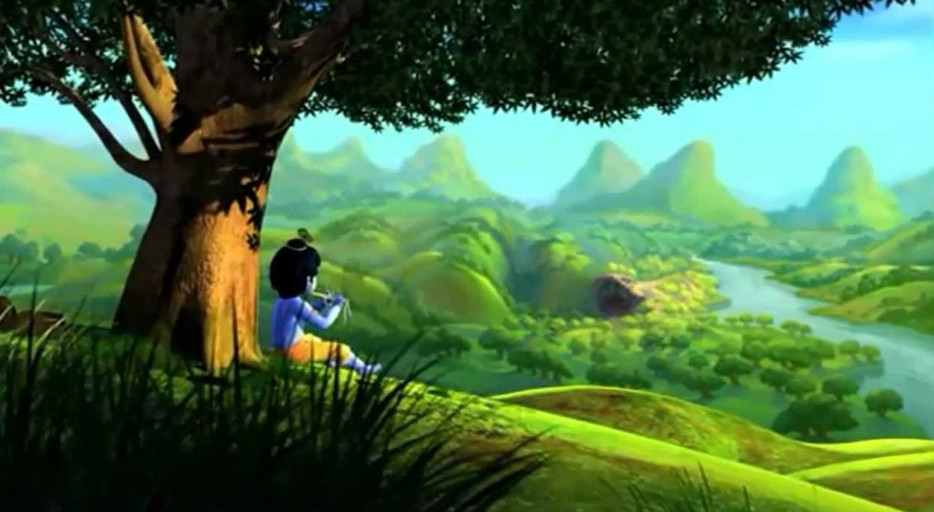
Vrindavan! – Descended from Goloka Vrindavan

Slide 5
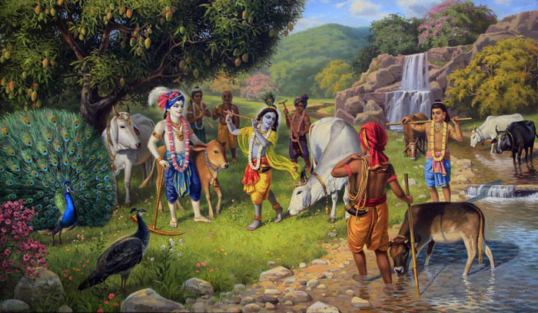
Notes:
We read from the scripture like Srimad Bhagavatam, how glorious were those days when Lord Krishna was in this workd, performing so many pastimes!

Slide 6
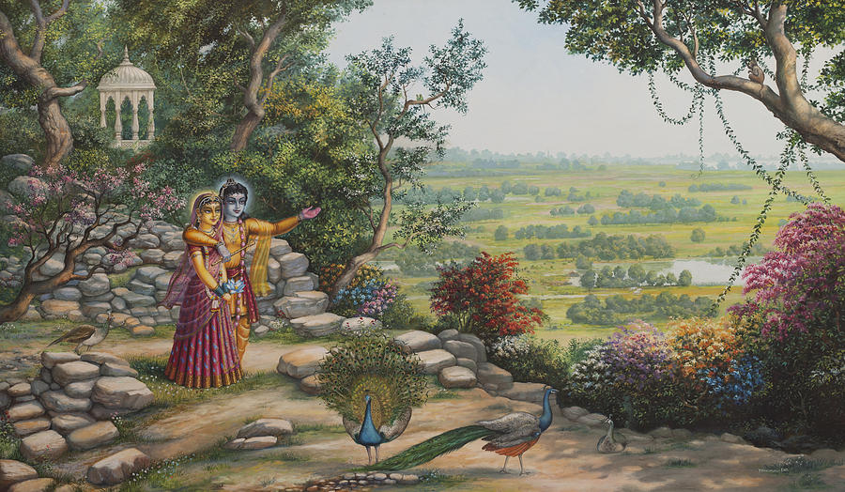
Notes:
The Govardan from Goloka Vrindavan manifested here and provided a very nice stage for the pastimes.

Slide 7
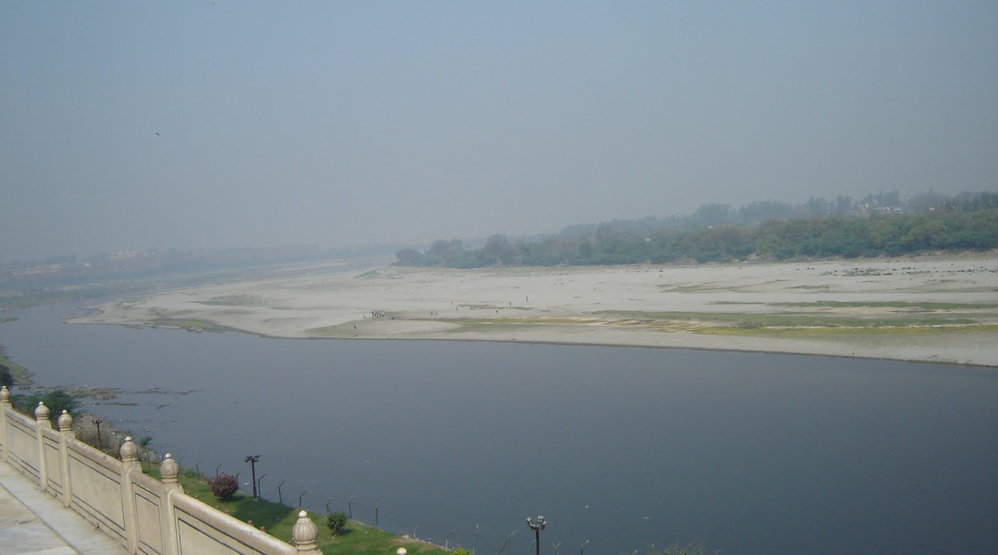
Notes:
And the Yamuna, who is the sister of Yama Raja manifested her beauty in Vrindavan.
So many pastimes were performed in and on the banks of Yamuna.

Slide 8
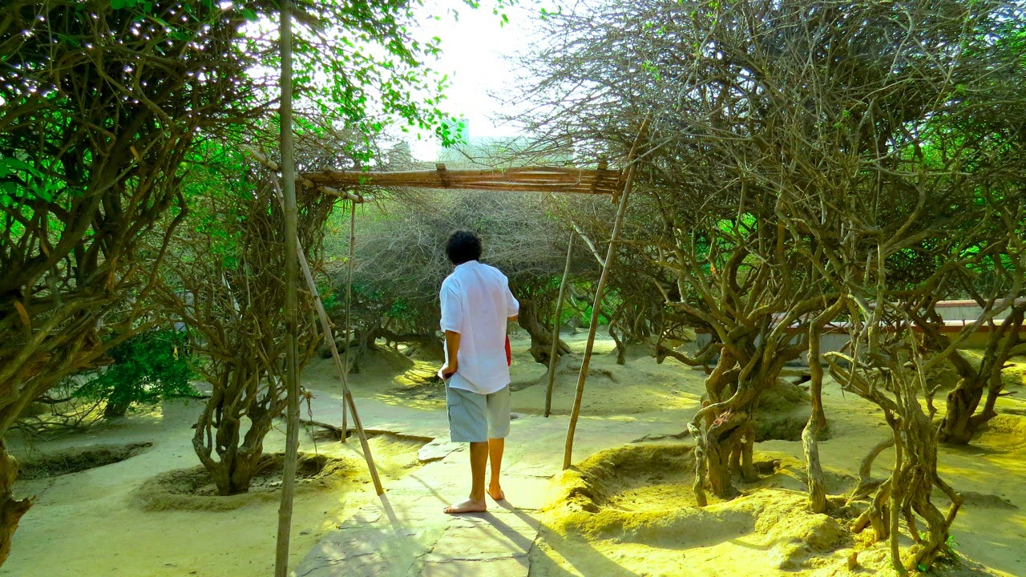
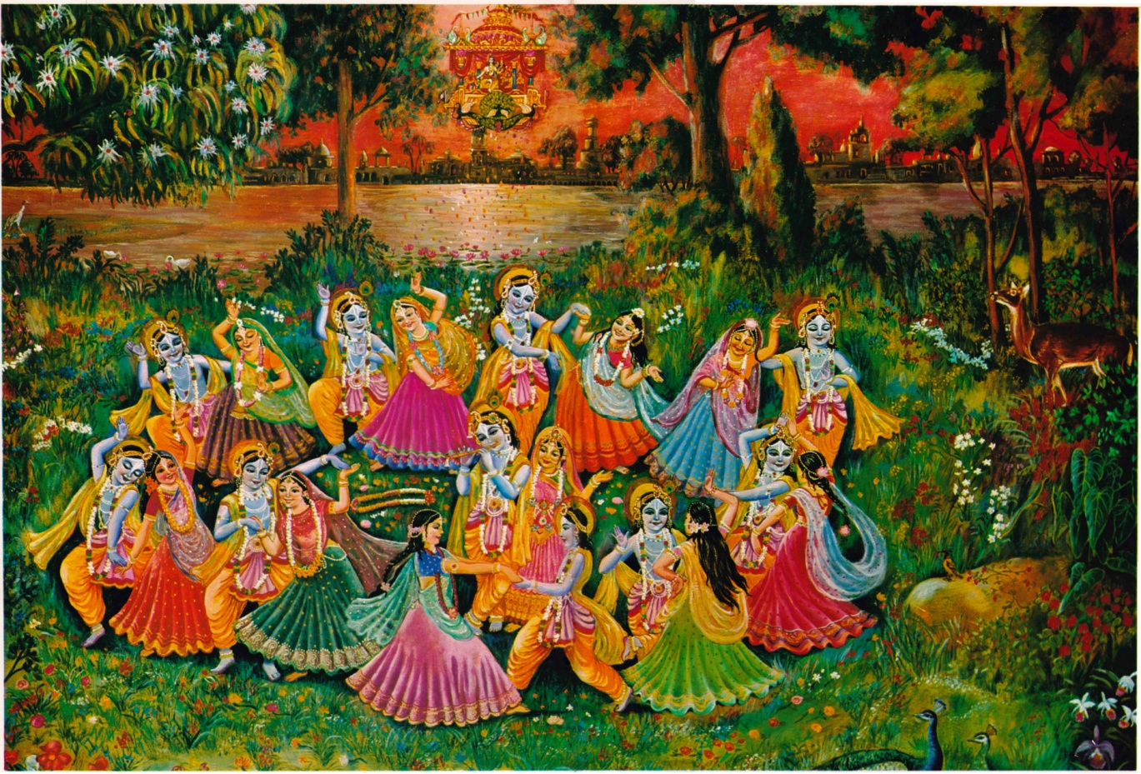
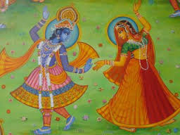
Notes:
All those pastimes are always manifesting in the hearts of pure bhaktas.. even now, all the time..
Those who meditates on Ashta kaliya Leela will know this more..

Slide 9
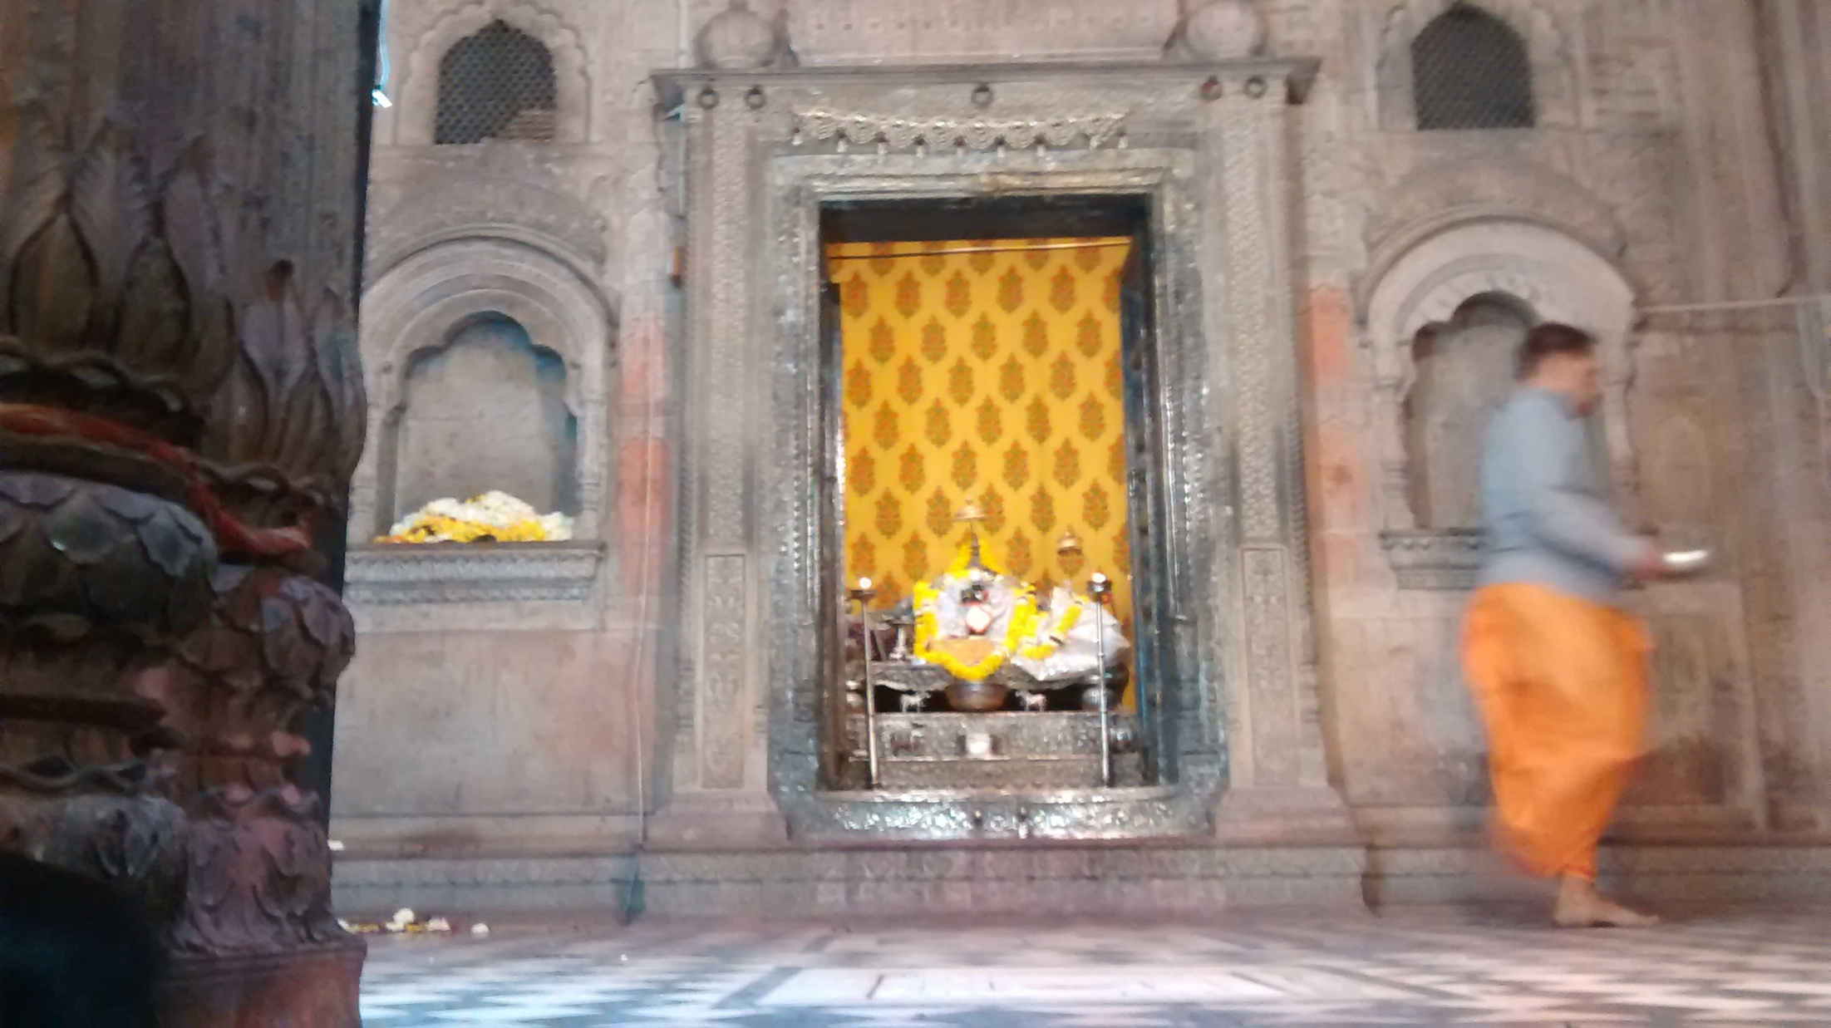
Notes:
Our trip to Vrindavan was very short.
We came from Jaipur on a car.
As it was so late to start, we reached much later than we planned..
We had only 4 hours for everything including the very huge list of shopping for our families and children.
In between shopping, we could go for very few nearby temples and holy places only
The first temple we visited was the temple of Sri Radha Raman!
Seeing Radha Raman is like seeing Radha Gopinatha (Face), Radha Govinda (Chest) and Radha Madan Mohana (Feet).

Slide 10
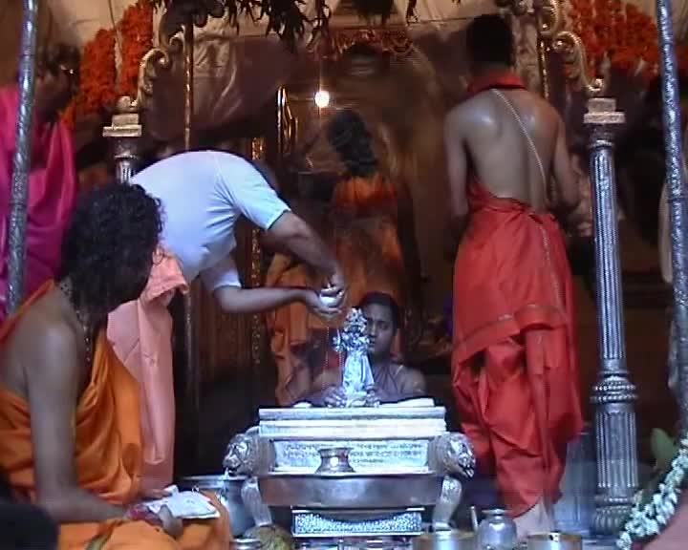
Notes:
On the appearance day of Sri Radha Ramana, they have a very special bathing!!!
It is very special as they do it in front of the public.
On this day we can also see the wooden plank give to Sri Gopala Bhatta Goswami by Sri Caitanya Mahaprabhu.

Slide 11
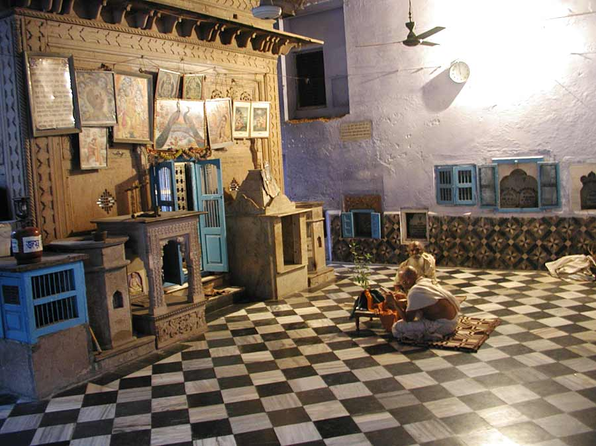
Notes:
In Vrindavan we see the Samadhi mandir of Sri Gopala Bhatta Goswami..

Slide 12
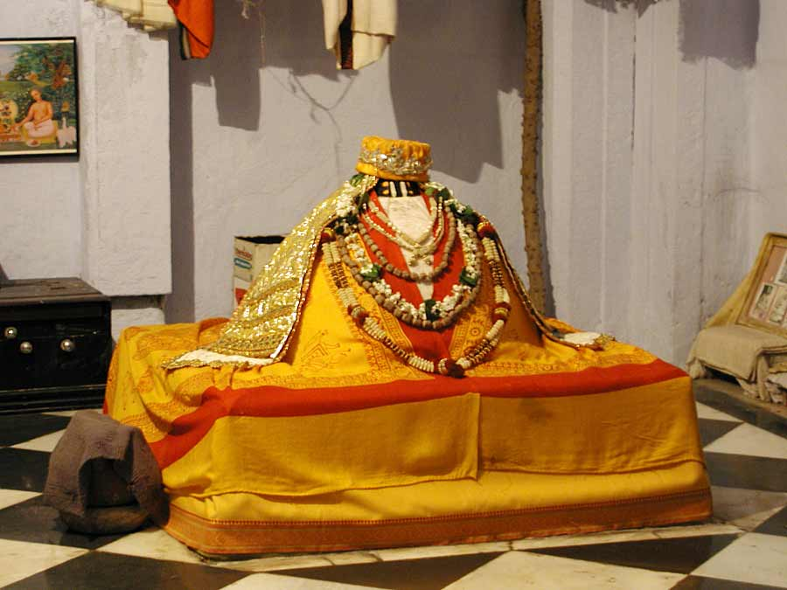

Slide 13
Notes:
In the MAHA Mantra, whet does the RAMA represent?
RAMA represents RAMANA.. Lord RAMA is also included as He has the root name too.
Also some even chant and sing starting with Hare Rama Hare Rama... This is not correct.
Lord Rama is the 3rd level of Expansion / Avatar. Krishna -> Balaram -> Vasudeva, Sankarshan, Aniruddha, Pradyumna.

Slide 14
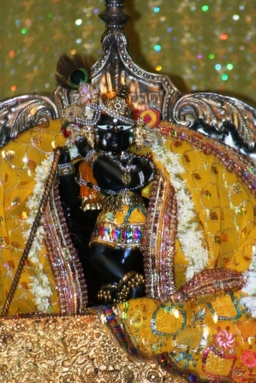
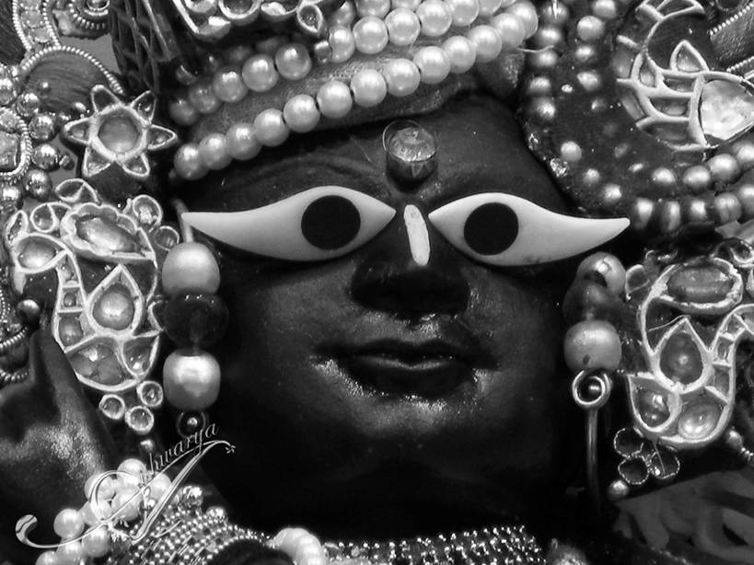
Notes:
As you may know, Radha Raman is a self manifested deity from a salagram worshipped by Sri Gopala Bhatta Goswami.
How did it happen? Who was Sri Gopala Bhatta Goswami? When did it happen? How?
Let us all go back in time to about 500 years back, when Lord Caitanya was on earth performing His amazing pastimes.

Slide 15
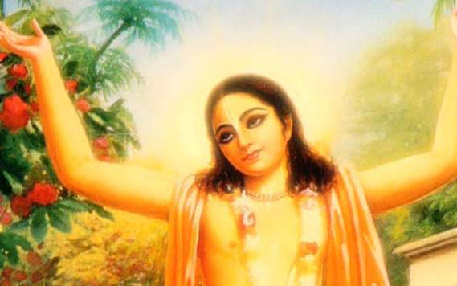
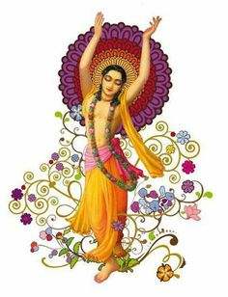
Notes:
The all merciful Lord Sri Gaur Hari, as He travelled from village to village throughout the south of India, continued to distribute love of Godhead wherever He went.
Hearing the nectarean names of Hari from His lotus mouth, thousands and thousands men and women felt relief from the blazing fire of material existence. The lives of thousands of fallen souls were so fortunate and thus they became virtuous and happy.

Slide 16
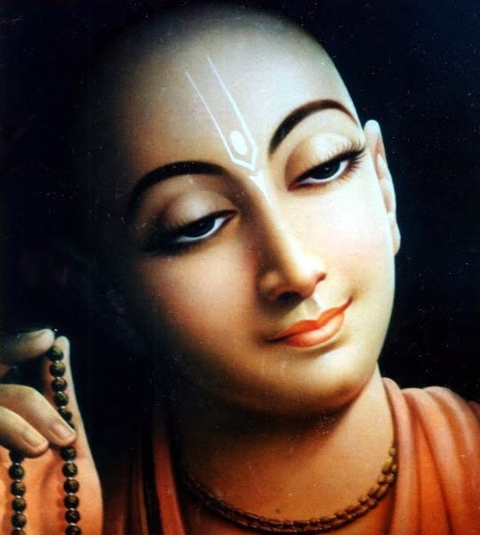
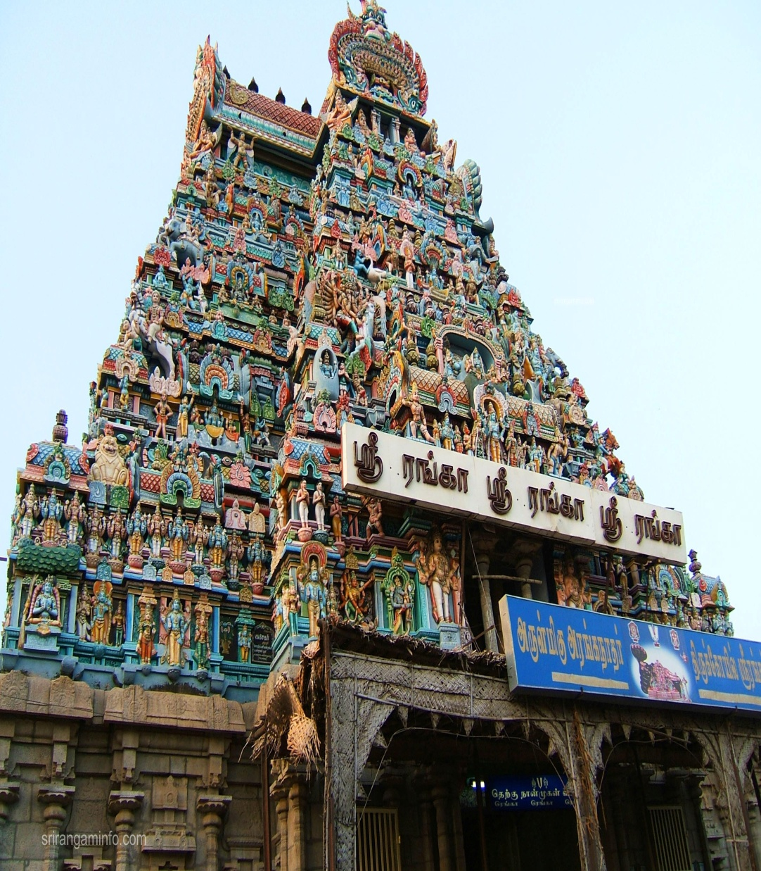
Notes:
While causing rains of love of God to fall anywhere and everywhere, without consideration of time or place, Sri Gaurasundor came to the ancient holy place of Sri Rangakshetra on an island in the middle of the Kaveri river.
The temple of Sri Ranga Kshetra was extremely large, the crest of the temple tower pierced the sky. Throughout the day and night hundreds and thousands of pilgrims were going and coming to take darsan of Lord Ranganath. The temple hall resounded with the sounds of hundreds and thousand of brahmanas chanting Vedic hymns. In the midst of this scene from Svetadwipa, entered Sri Gaurasundar chanting the names of Krsna in his sweet voice that defeated the voices of millions of gandharvas.
Everyone in the temple became dumbstruck, amazed and thrilled with wonder. What unprecedented beauty; His bodily effulgence makes molten gold appear lack-lustre. From His eyes which are like the full blown petals of a lotusflower trickled down tears of ecstatic love. Every limb, every part of His body was filled with such exquisite grace that even the mind of cupid gets stolen away. The brahmanas began to consider, "Is this a demigod? Can such symptoms and emotions be found in human beings?"

Slide 17
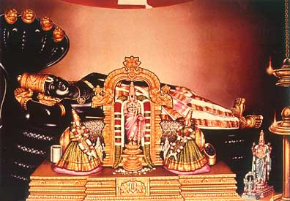
Notes:
Again resounding the halls with the transcendental vibrations of Sri Hari's name, when He came before the Deity and fell down as a tree is blown down by the wind, some people thought that a mountain of gold was rolling on the ground.
Sri Vyenkata Bhatta seeing this divine personage became restless with ecstasy. His heart being flooded with devotion he got up and began to move the crowds away so that the Lord could engage in chanting and dancing.
When the Lord had regained His external consiousness after engaging in sankirtan, Vyenkata Bhatta approached Him and took the dust of His lotusfeet.
Mahaprabhu gazed towards him and saying, "Krsna! Krsna!" embraced him firmly.
Sri Vyenkata Bhatta invited Mahaprabhu to come to his house and having brought Him there, very reverantly washed His lotusfeet and along with the other family members, he drank the water. Sri Bhattaji's house became filled with joy.

Slide 18
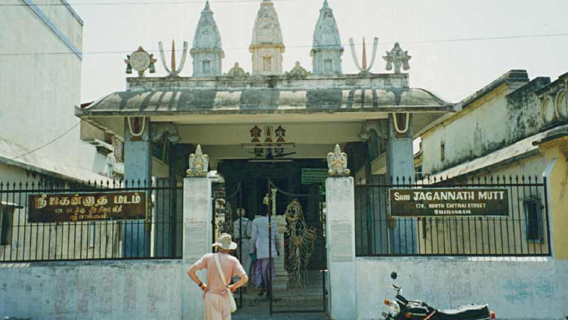
Notes:
When we visited the place where Lord Caitanya was staying during His Catur masya stay, this is the very same place where he stayed.
Now it is called ‘Jagannath Mutt’.
We had a fortune of spending some time along with the direct descendent of the family where Gopala Bhatta Goswami was born and brought up. His name is Murali Bhatta.

Slide 19
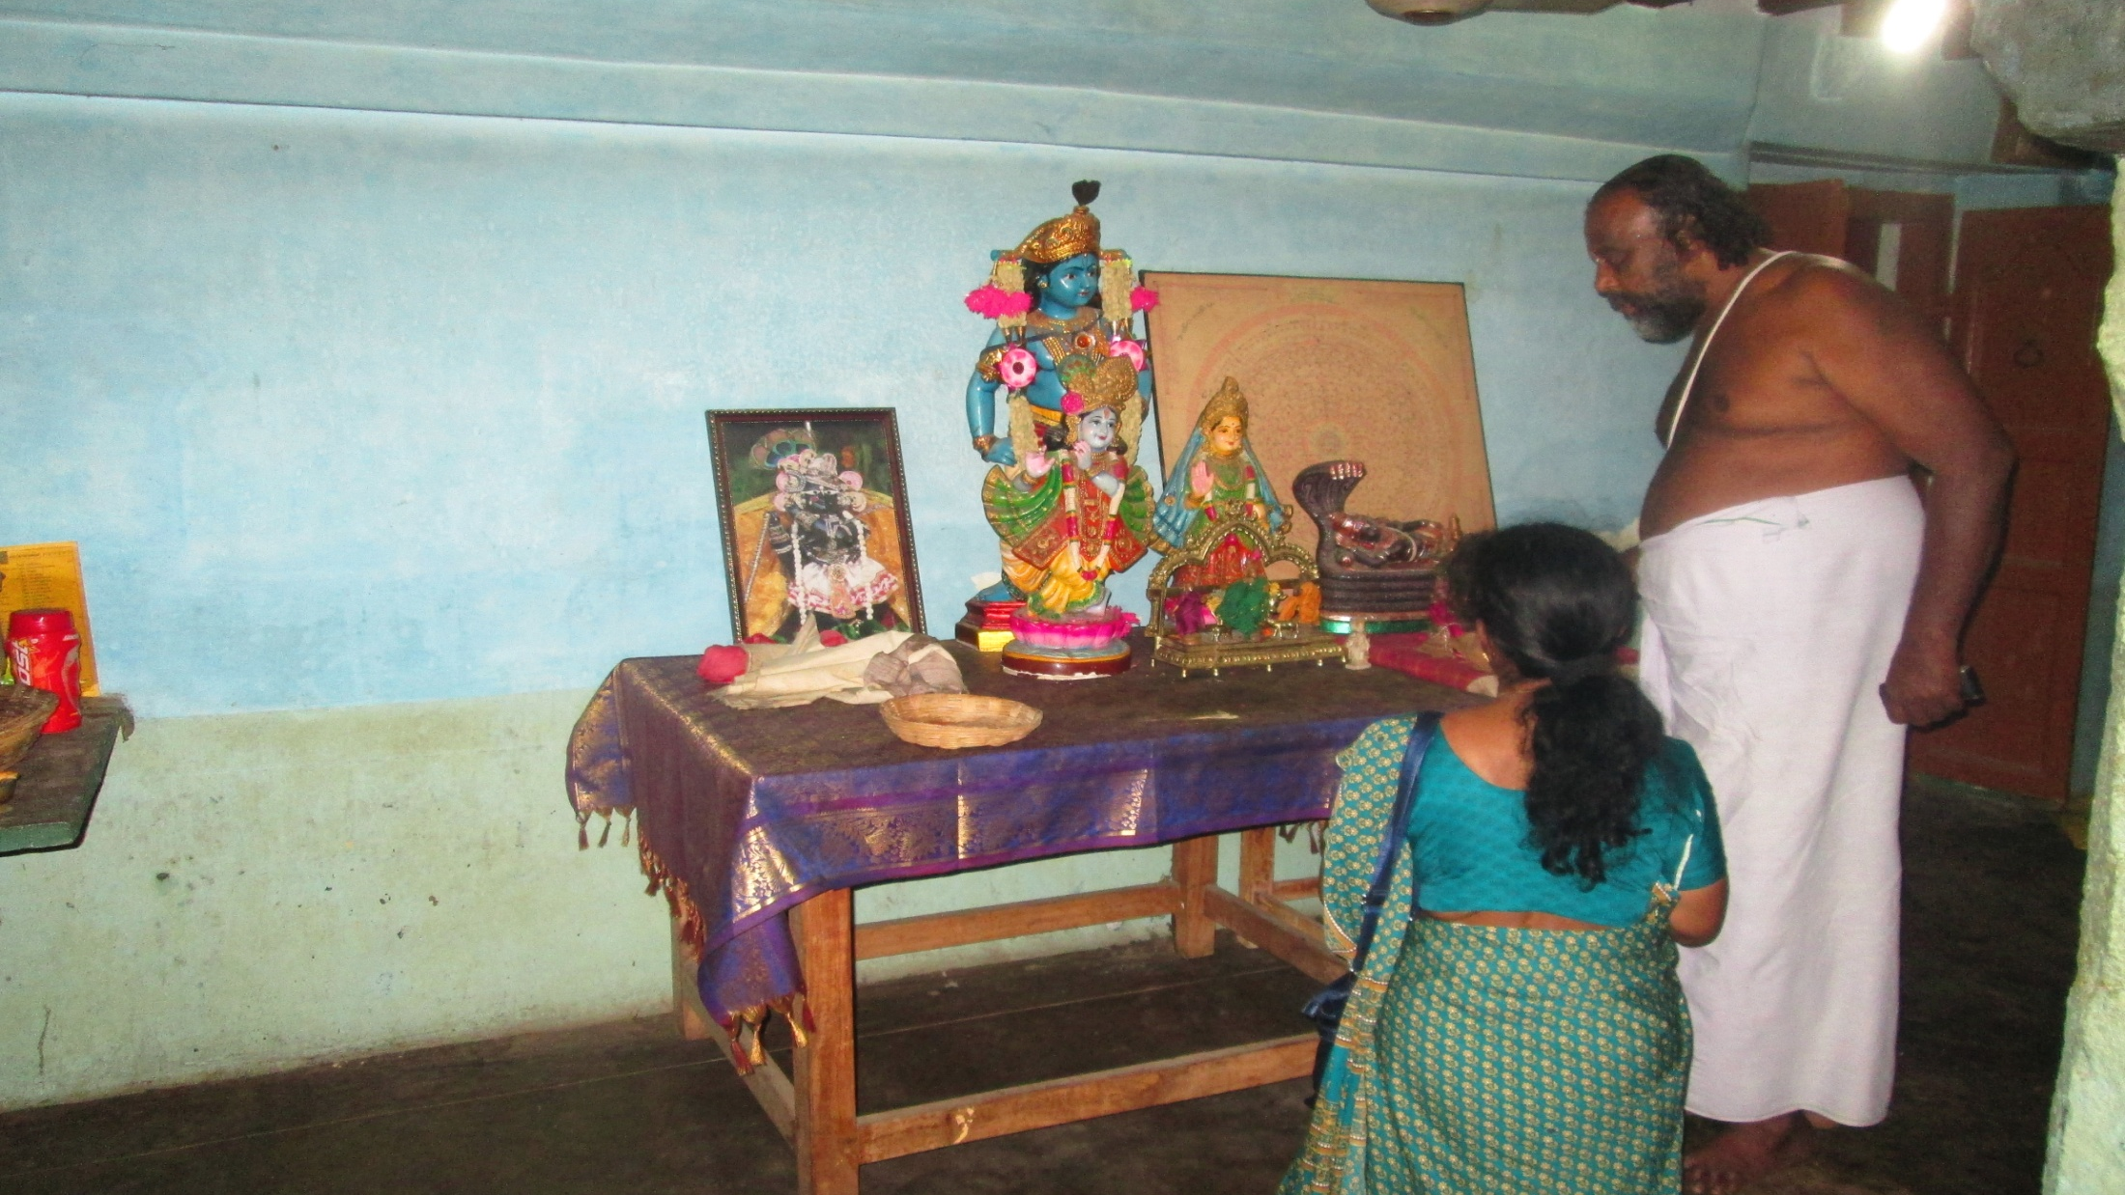
Notes:
When we visited the place where Lord Caitanya was staying during His Catur masya stay, this is the very same place where he stayed.
Now it is called ‘Jagannath Mutt’.
We had a fortune of spending some time along with the direct descendent of the family where Gopala Bhatta Goswami was born and brought up. His name is Murali Bhatta.

Slide 20
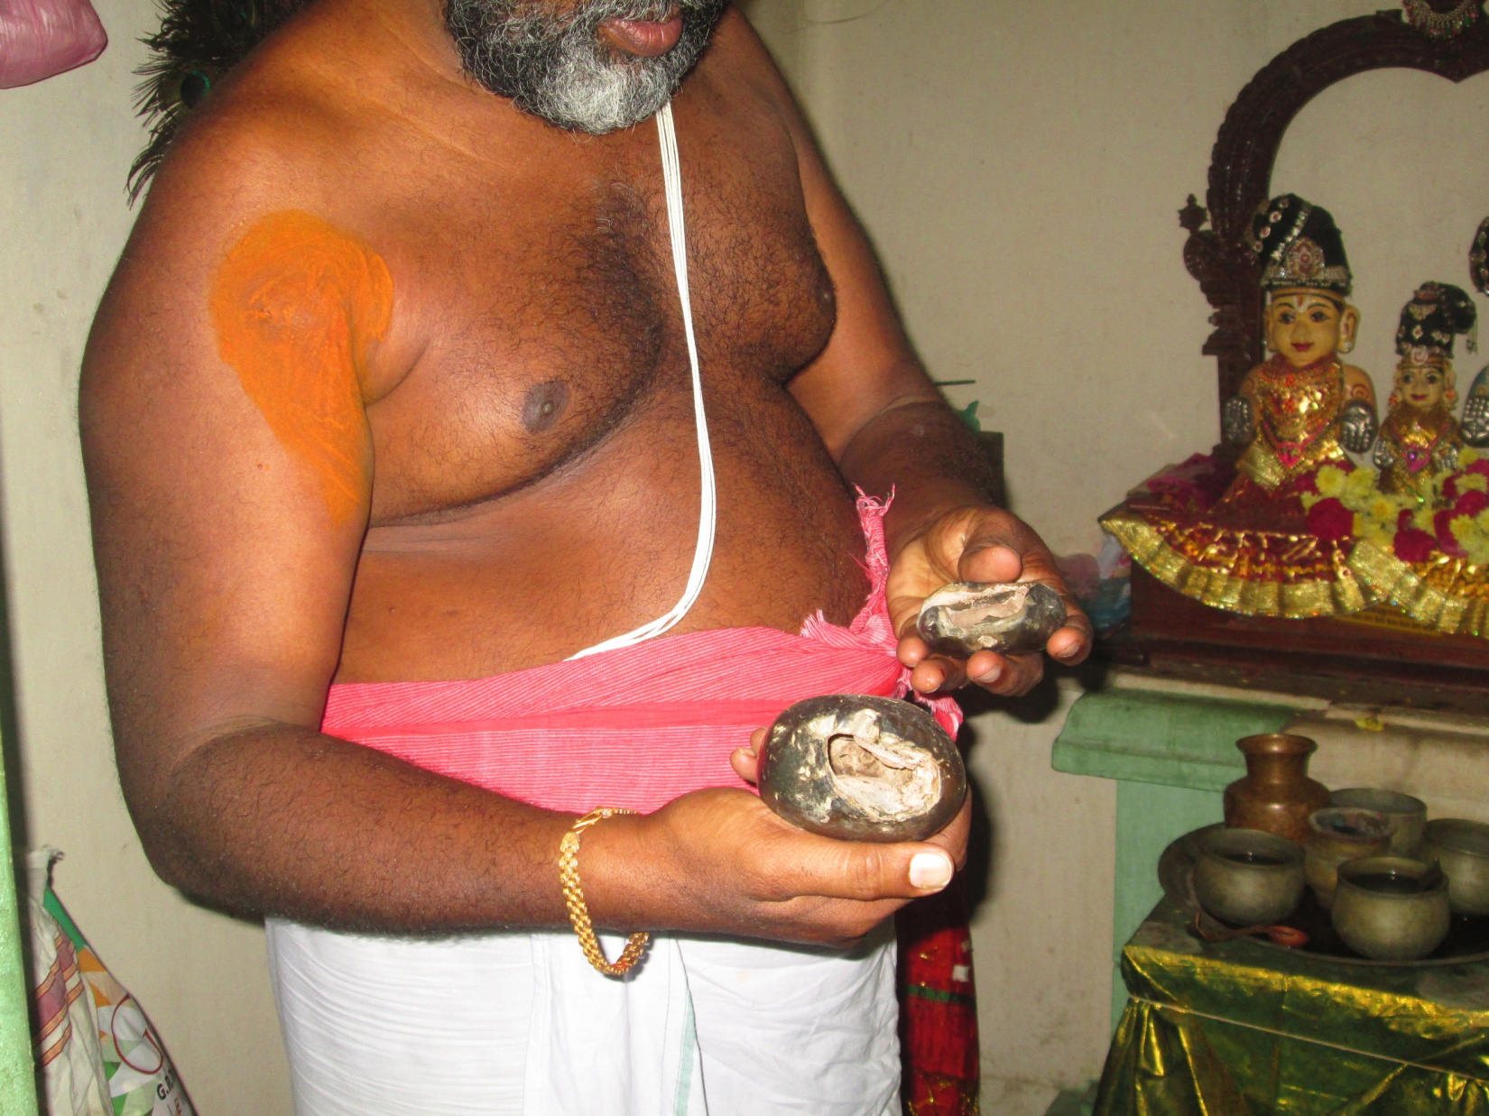
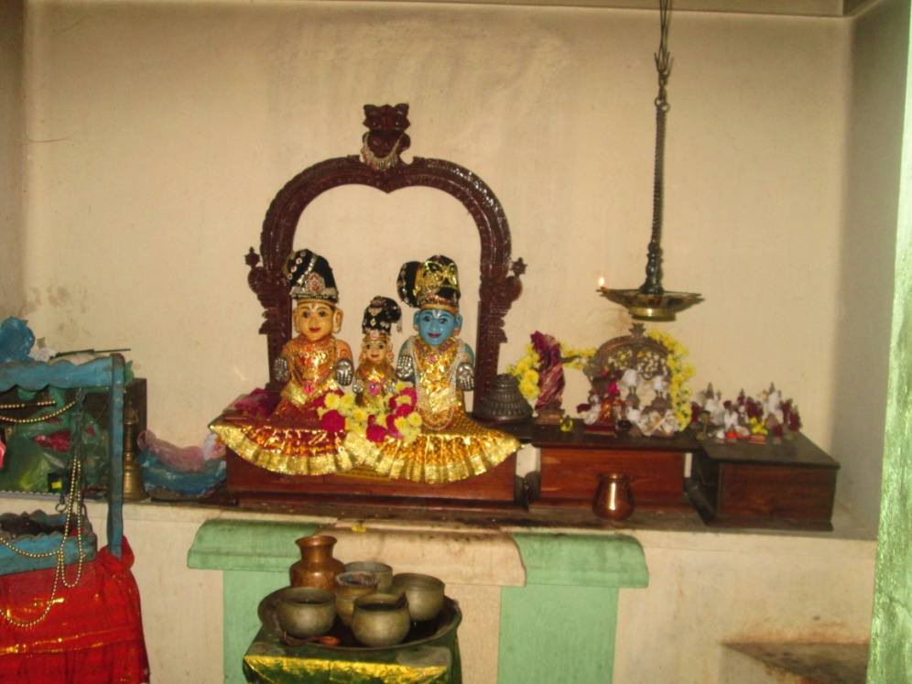
Notes:
He took us inside the small sanctum where the deity personally carved by Sri caitanya Mahaprabhu are kept and worshipped nicely.
Also showed special Salagrams.

Slide 21
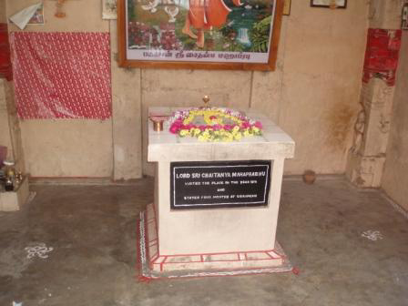
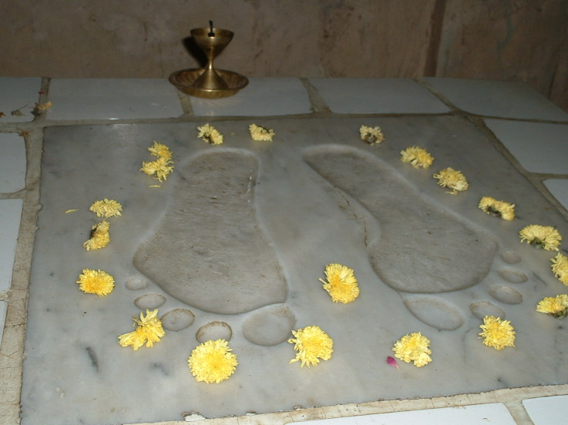
Notes:
Also just outside the Srirangam temple, they have the foot prints of Lord Caitanya Mahaprabhu..

Slide 22
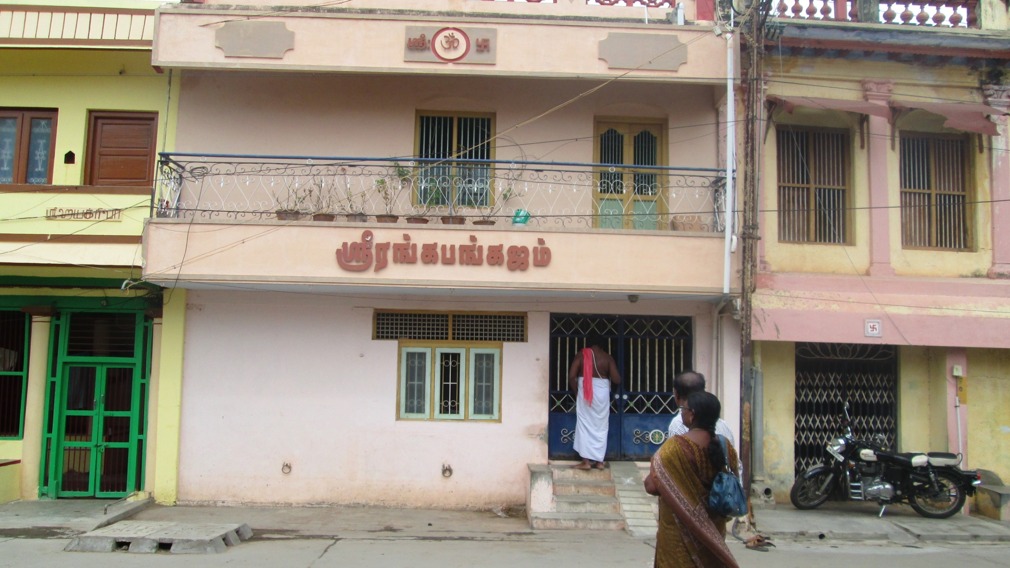
Notes:
This is the renovated home of Vyenkata Bhatta – opp to Jagannath Mutt.
Mahaprabhu came to Ranga Kshetra in the Christian year 1511.
Vyenkata Bhatta had two brothers, Tirumalla Bhatta and Prabodhananda Sarasvati.
They all belonged to the Ramanuja sampradaya and Prabodhananda Sarasvati was a tridandi sannyasi of that order.
Vyenkata Bhatta had a son named Gopal, who was then just a child.
When the boy came to offer his obeisances at the lotusfeet of Mahaprabhu picked him up and very affectionately seated him in His lap.
Mahaprabhu would call Gopal after He had finished His meal and offer His remnants to the boy.
In this way He prepared him for the positon of Acarya. Mahaprabhu would tell the boy stories of Krishna.

Slide 23
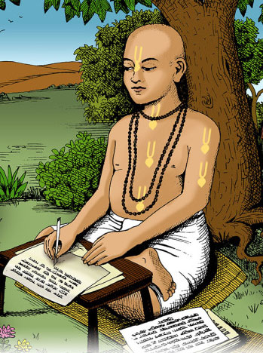
Notes:
Once Lord caitanya mahaprabhu showed His form as Lord Krishna..
That made Gopala Bhatta ecstacy.
After remaining at Vyenkata Bhatta's house during the four months of the rainy season (Chaturmasya) Mahaprabhu prepared to continue His journey.
Gopal fell at His lotusfeet in a dead faint. Therefore Mahaprabhu remained for a couple of more days in order to con-sole the boy.
Being pleased with Gopala Bhatta Gosvami's sincere service and devotion, Sri Caitanya Mahaprabhu initiated him, and ordered him to move to Vrndavana after the disappearance of his parents and perform bhajan and write.
He instructed him to serve his mother and father and always engage in chanting Krsna's glories and ONLY thereafter to come to Brindavan.

Slide 24
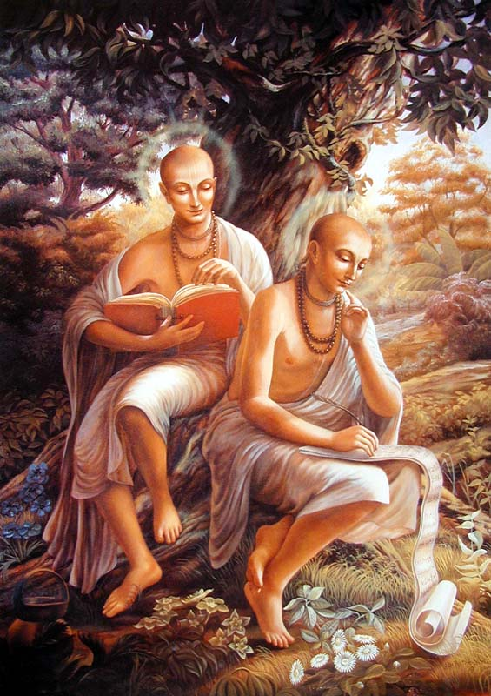
Notes:
At the age of thirty Gopala Bhatta Gosvami came to Vrindavana, and having missed Sri Caitanya Mahaprabhu this saddened him.
Thus Gopal set out for Vrindavan and when he arrived there Rupa Gosvami immediately sent word to Mahaprabhu to inform Him of Gopal's arrival there.
Mahaprabhu had previously indicated to Rupa and Sanatan that Gopal Bhatta would one day come there to Brindavan, so upon his arrival they treated him with the same care and affection they would their own brother.
They immediately became life long companions.

Slide 25
Notes:
When Sri Caitanya Mahaprabhu received word that Gopal Bhatta had come to Vrindavan, He was very pleased and sent with that messenger with the Lord's personal wooden sitting plank (hoki) which He had used along with a pair of His undergarments and one of His upper cloths - uttara or chaddar.
"Having received these gifts Gopal Bhatta was in ecstasy and he worshipped them as the prasad (tadiya) of Mahaprabhu.
Whenever he would worship his Deities he would sit on that wooden plank. This wooden seat and Mahaprabhus clothes are still being worshipped at Radha-Ramana Mandir.
Gopala Bhatta, like Rupa and Sanatana, had no fixed residence and would spend the night in various kunjas (forest groves). He spent his time studying the scriptures and composing various literatures.

Slide 26
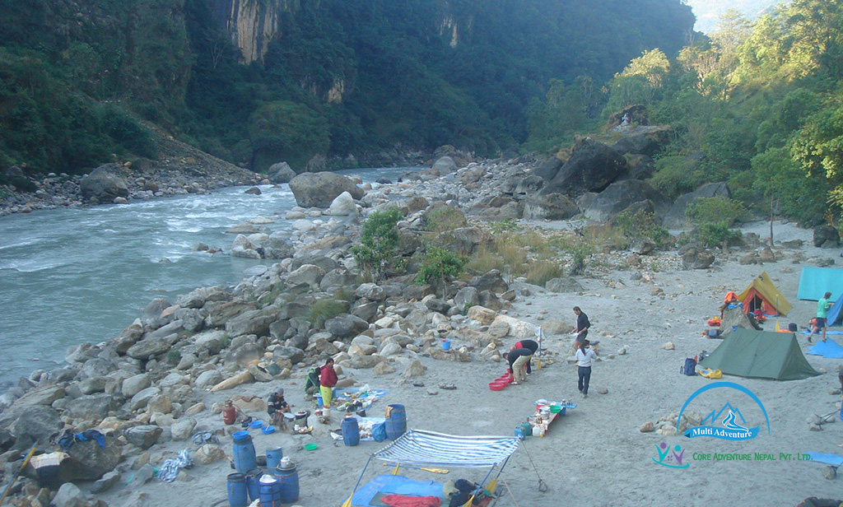
Kali Gandaki River
Notes:
After Sri Caitanya Mahaprabhu's disappearance Gopala Bhatta Gosvami felt intence separation from the Lord.
To relieve his devotee, the Lord instructed Gopala Bhatta in a dream :"If you want my darsan then make a trip to Nepal".
In Nepal, Gopala Bhatta bathed in the famous Kali-Gandaki River. Upon dipping his waterpot in the river, he was surprised to see several Shaligrama Shilas enter his pot. He dropped the shilas back into the river, but the shilas re-entered his pot when he refilled it.
After emptying and refilling his waterpot for the third time, Gopala Bhatta Gosvami found twelve Shaligrama shilas sitting there. Thinking this must be the Lords mercy, he kept all the shilas and returned to Vrndavana.

Slide 27
Notes:
You can see people searching for saligram.

Slide 28
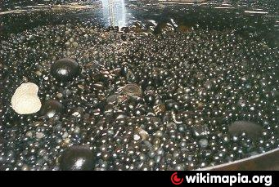
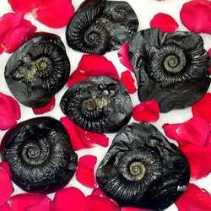
Notes:
So many saligrams are being given bath.

Slide 29
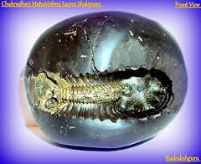
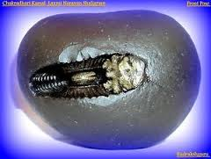
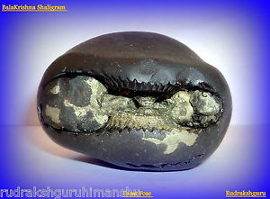
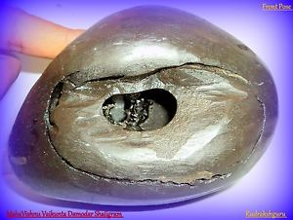
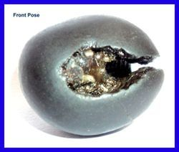
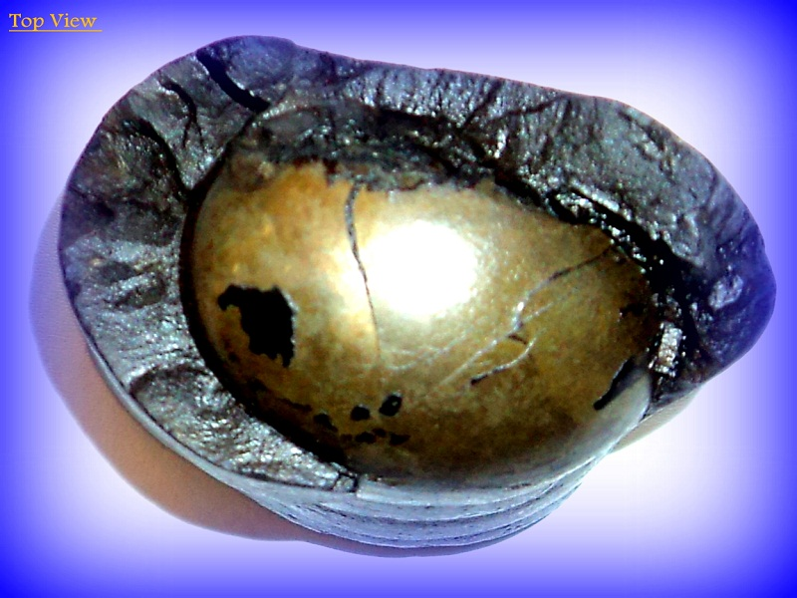
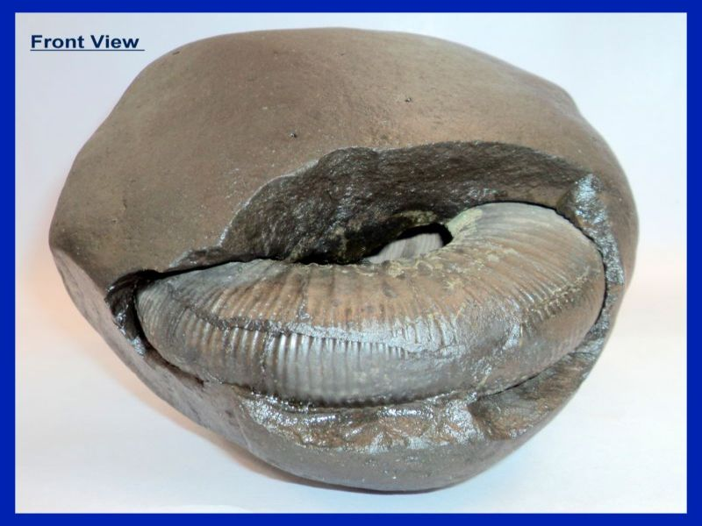
Notes:
Salagrams are so special and they are the deity forms of various forms of Vishnu.

Slide 30
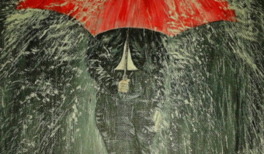
Notes:
While on the way, there was heavy rain once and a devotee by seeing Gopala Bhatta Goswami trenched in the rain, took him to his house under his umbrella.
That family did not have any children, and they lost the hope.
Sri Gopala Bhatta Goswami gave blessings to the family to have a boy.

Slide 31
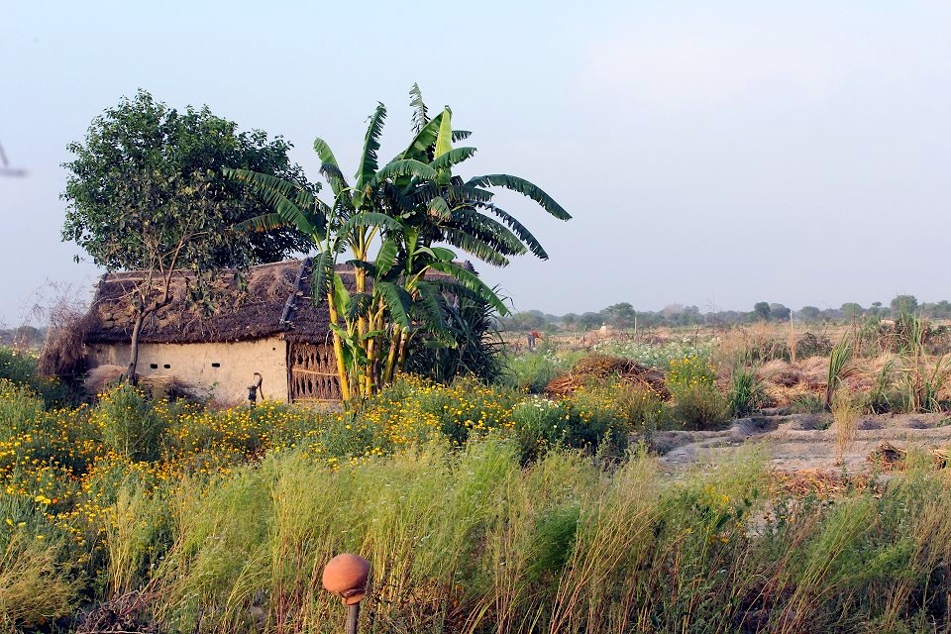
Notes:
Returned to Vrindavan, He had a small place where he setup the worship of the Salagramas.

Slide 32
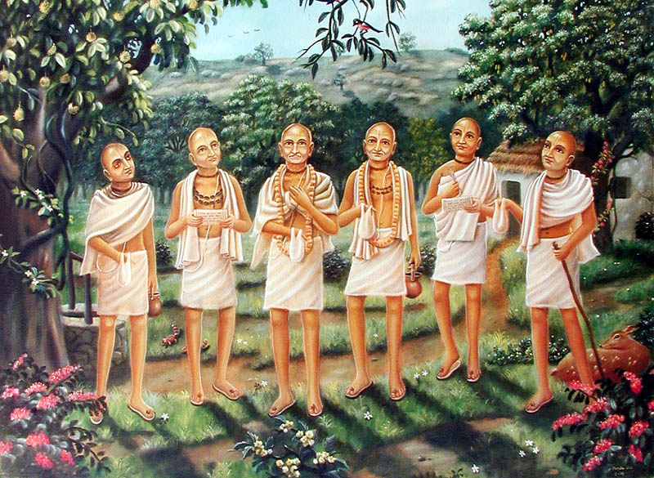
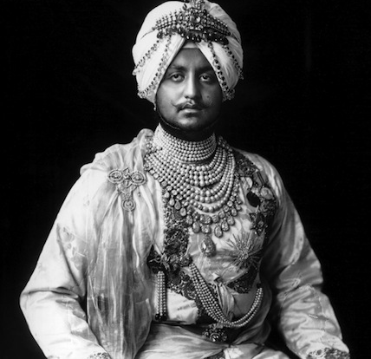
Notes:
One day a wealthy man (Seth) came to Vrndavana and offered Gopala Bhatta a variety of clothing and ornaments for his Shaligrams.
Being very impressed with the Gosvami he wanted his darshan and to render some service which he presented in the form of some valuable cloths and ornaments.
However, Gopala Bhatta couldn't use these for his round-shaped Shaligrams, so he advised the donor to give the Deity decorations to someone else, but the
Seth insisted. Gopala Bhatta kept the cloths and ornaments with his shilas.

Slide 33
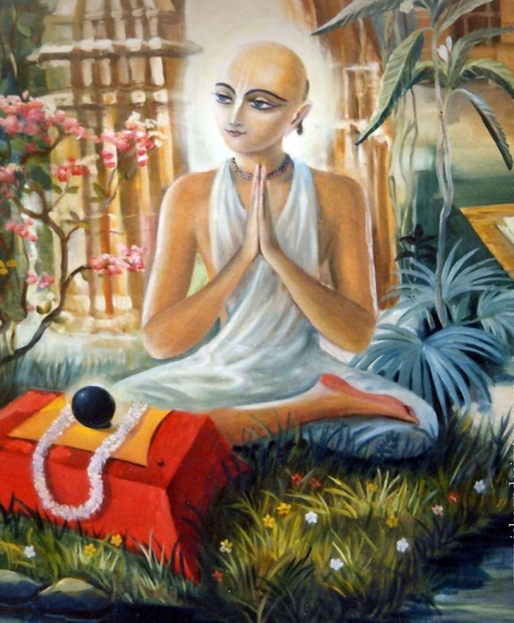
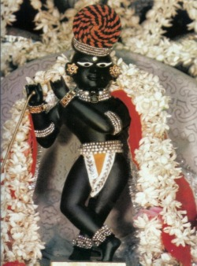
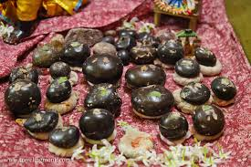
Notes:
That day of Narasimha Cathurthi..
At night while Gopala Bhatta Gosvami was absorbed in remembering how the half-man, half-lion form of the Supreme Lord had manifested from the pillar in Hiranyakasipu's palace.
He prayed to the Lord: "Oh my Lord, you are very merciful and always fulfill the desires of your devotees. I wish to serve you in your form, having arms and legs and blissful smiling face, with lotus eyes.... If I had a Deity then I would be able to decorate Him so nicely with these clothes and ornaments.“
In the evening after offering some bhoga and arotika to his Shalagram shilas, Gopala Bhatta put them to rest, covering them with a wicker basket. Late in the night, Gopala Bhatta took a little rest
and then, in the early morning went to take bath in the Yamuna river.
Returning from his bath, he uncovered the Shalagramas in order to render the puja for Them, and saw amongst Them a Deity of Krishna playing the flute.

Slide 34
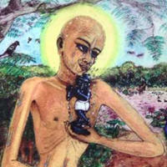
Notes:
There were now eleven shilas and this Deity.
The "Damodara shila", had manifested as the beautiful three-fold bending form of tri-bhangananda-krishna.
Floating in the ocean of ecstasy, he fell to the ground in order to offer his dandavats and then recited various prayers and hymns.
This wonderful event of the appearance day of RadhaRaman happened on the day after Sri Nrisimha Chaturdasi.

Slide 35
CB-03
Aamaara bhaktera
Pujaa aamaa haite bara
Sei prabhu vede
Bhaagavate kaila darha [Caitanya Bhagavata 1.1.8]
[The Lord has declared in the Vedas and in the Srimad Bhagavatam that, worshipping or serving His devotee is even greater than worshiping Him. ]
Notes:
Lord Krishna is bound by His dear devotees.
He also declares that worshipping His devotees and serving is better than worshipping Him.

Slide 36
Notes:
When Rupa and Sanatana Gosvamis as well as many other devotees received news of this miraculous event they came running to see the Lord.
Gazing on the Lord's transcendental form, which bewildered all the living entities of the many various planets, they all bathed Him with their tears. This Deity whom the Gosvamis named, "Sri Radha-Raman Deva" made His appearance on the full moon day of Vaisakha in the year 1542.
Out of Krishna deities, Sri Radha-Ramanaji is the only one of the original Deities of Vrindavana who never left to go to Jaipur.
Sri Sri Radha-raman-ji is still being worshipped in Vrindavana near Nidhuban kunj in the compound of the temple.

Slide 37
Notes:
Sri Radha-ramana Deva, unlike other Deities, has very intricate features, including fingernails and even teeth. On the back side of His body parts of the original Shalagram shila from which He manifested Himself can be seen.
There is a story that the small son of one of the sevaits was playing with the Deity once and put a small stick in one ear of the Deity and pushed it through out the other ear. The stick however, had blood on it, and that boy died vomiting blood that very day.

Slide 38
Notes:
The Deity is called Radha-Raman although physically there is no apparent Deity of Radha there. As one can see from the picture at the top of this page, that to the right of the picture (to Ramanji's left) is a place setting for Srimati Radhika. In this way the pujaris worship Sri Radha and Ramanji together.
Worshipping Radha Raman is equivalent to worshipping 3 deites:
Radha Gopinatha (face)
Radha Govinda (Chest)
Radha mMdana Mohana (Feet)

Slide 39
Radha Ramana Bol Hari Bol
Radha Ramana Bol Hari Bol
Radha Radha Bol
Radha Ramana Bol .... (Radha)
Radha Madana Mohanaa Bol
Radha Madana Mohana Bol
Radha Radha Bol
Radha Madana Bol .... (Radha)
Radha Govinda Madhava Bol
Radha Govinda Madhava Bol
Radha Radha Bol
Radha Govinda Bol .... (Radha)
F-07
Notes:
Here is a special quick song made for glorifying Radha Ramana!

Slide 40
Play Video
Presenting a Video Production of F-05-O Radhey Jaya Radhey
Notes:
And here is a video for the last bhajan introduced uniquely for Sri Radha Rani ..
Shivani from India has expressed her interest in singing this for the next CD.

Slide 41
THANK YOU!
Hare Krishna!
Sri Sri Radha Raman Ki Jay!
Notes:
Now we will perform the special abhisekam for Sri Rama Raman.
We request every family to come together and offer the bath..

